Slide 1
RSA
Developed in 1977 at MIT by Ron Rivest, Adi Shamir & Len Adleman
This lecture is mainly based on the power point slides by Professor Lawrie Brown.
Notes:
Zili Shao

Slide 2
Private-Key Cryptography
Traditional private/secret/single key cryptography uses one key
  shared by both sender and receiver
If this key is disclosed, communications are compromised
The key also is symmetric, parties are equal
  it does not protect sender from
    receiver forging a message & claiming is sent by sender
CEG 260, Meilin Liu
Notes:
Zili Shao
So far all the cryptosystems discussed have been private/secret/single key (symmetric) systems. All classical, and modern block and stream ciphers are of this form.

Slide 3
Public-Key Cryptography
Probably most significant advance in the 3000 year history of cryptography
It uses two keys – a public & a private key
It is asymmetric: parties are not equal
It uses clever applications of number theoretic concepts to function
It complements rather than replaces private key cryptography
CEG 260, Meilin Liu
Notes:
Zili Shao
Will now discuss the radically different public key systems, in which two keys are used. Anyone knowing the public key can encrypt messages or verify signatures, but cannot decrypt messages or create signatures, counter-intuitive though this may seem. It works by the clever use of number theory problems that are easy one way but hard the other. Note that public key schemes are neither more secure than private key (security depends on the key size for both), nor do they replace private key schemes (they are too slow to do so), rather they complement them.

Slide 4
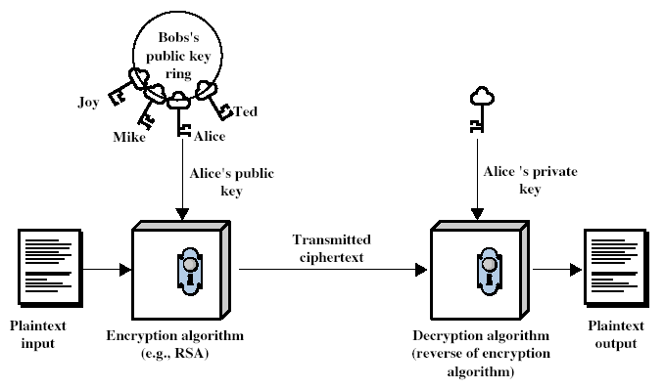
Public-Key Cryptography
CEG 260, Meilin Liu
Notes:
Zili Shao
Stallings Fig 9.1

Slide 5
Public key encryption
Bob: generates (KUb, KRb) and gives KUb to Alice
Alice
Bob
m
E
c
c
D
m
KUb
KRb
Notes:
Note: asymmetric keys

Slide 6
Public-Key Cryptography
Public-key/two-key/asymmetric cryptography involves in, for each agent u, the use of its associated pair of keys <KU, KR> :
  the public key KU which is published under the user’s name in a ``public directory” accessible for everyone to read,
    can be used to encrypt messages, and verify signatures
  the private-key KR which is known only to the agent u,
    used to decrypt messages, and sign (create) signatures
It is asymmetric because
  Those who encrypt messages or verify signatures may not be able to decrypt messages or create signatures
CEG 260, Meilin Liu
Notes:
Zili Shao

Slide 7
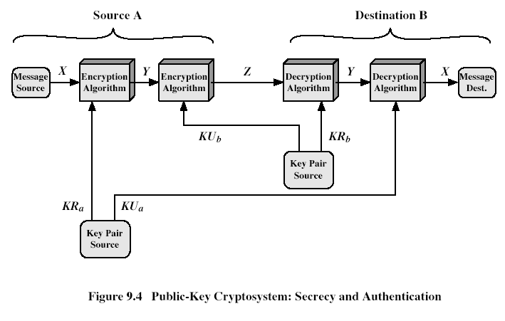
Use of Public-Key Cryptosystems
CEG 260, Meilin Liu
Notes:
Zili Shao
Stallings Fig 9.4
Here see various components of public-key schemes used for both secrecy and authentication. Note that separate key pairs are used for each of these – receiver owns and creates secrecy keys, sender owns and creates authentication keys.

Slide 8
Public-Key Applications
Three major categories:
  encryption/decryption (provide secrecy)
  digital signatures (provide authentication)
  key exchange (of session keys)
Some algorithms are suitable for all uses, others are specific to one
CEG 260, Meilin Liu
Notes:
Zili Shao

Slide 9
RSA
The scheme developed by Rivest, Shamir, and Adleman makes of MIT in 1977
Best known & widely used public-key scheme
Based on exponentiation in a finite (Galois) field over integers modulo a prime
  nb. exponentiation takes O((log n)³) operations (easy)
Uses large integers (eg. 1024 bits)
Security due to cost of factoring large numbers
  nb. factorization takes O(e ^{log n log log n}) operations (hard)
CEG 260, Meilin Liu
Notes:
Zili Shao
RSA is the best known, and by far the most widely used general public key encryption algorithm.

Slide 10
RSA Key Setup
Each user generates a public/private key pair by:
Selecting two large primes at random: p, q, typically 512 bits
Computing their system modulus N=p*q, typically 1024 bits
  note ø(N)=(p-1)*(q-1)
Selecting at random the encryption key e (larger than 100 digits), that is relative prime to (p-1)*(q-1); i.e., 1<e<ø(N), gcd(e,ø(N))=1
Solve following equation to find decryption key d
  e*d=1 mod ø(N) and 0≤d≤N
Publish their public encryption key: KU={e,N}
Keep secret private decryption key: KR={d, N}
CEG 260, Meilin Liu
Notes:
Zili Shao
This key setup is done once (rarely) when a user establishes (or replaces) their public key. The exponent e is usually fairly small, just must be relatively prime to ø(N). Need to compute its inverse to find d. It is critically important that the private key KR={d,p,q} is kept secret, since if any part becomes known, the system can be broken. Note that different users will have different moduli N.

Slide 11
RSA – Cont.
For plaintext M and ciphertextC :
  Encryption : C = M^e (mod N).
  Decryption : M = C^d (mod N).
Note that the message M must be smaller than the modulus N
CEG 260, Meilin Liu
Notes:
Zili Shao
All security policies and mechanisms rest on assumptions; we’ll examine some in later chapters, most notably Chapter 22, Malicious Logic. Here is a taste of the assumptions.
Policies: as these define security, they have to define security correctly for the particular site. For example, a web site has to be available, but if the security policy does not mention availability, the definition of security is inappropriate for the site. Also, a policy may not specify whether a particular state is “secure” or “non-secure.” This ambiguity causes problems.
Mechanisms: as these enforce policy, they must be appropriate. For example, cryptography does not assure availability, so using cryptography in the above situation won’t work. Further, security mechanisms rely on supporting infrastructure, such as compilers, libraries, the hardware, and networks to work correctly. Ken Thompson’s modified C preprocessor (see the example on p. 615) illustrates this point very well.

Slide 12
RSA – Cont.
The Factoring Problem :
  The treat to larger key sizes is two folds: the continuing increase in computing power, and the continuing refinement of factoring algorithms.
CEG 260, Meilin Liu
Notes:
Zili Shao
All security policies and mechanisms rest on assumptions; we’ll examine some in later chapters, most notably Chapter 22, Malicious Logic. Here is a taste of the assumptions.
Policies: as these define security, they have to define security correctly for the particular site. For example, a web site has to be available, but if the security policy does not mention availability, the definition of security is inappropriate for the site. Also, a policy may not specify whether a particular state is “secure” or “non-secure.” This ambiguity causes problems.
Mechanisms: as these enforce policy, they must be appropriate. For example, cryptography does not assure availability, so using cryptography in the above situation won’t work. Further, security mechanisms rely on supporting infrastructure, such as compilers, libraries, the hardware, and networks to work correctly. Ken Thompson’s modified C preprocessor (see the example on p. 615) illustrates this point very well.

Slide 13
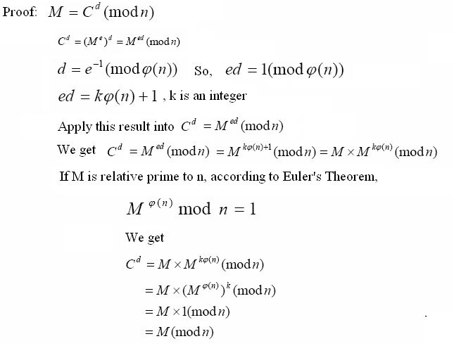
RSA – Proof, When GCD(M,n)=1
CEG 260, Meilin Liu
Notes:
Zili Shao
All security policies and mechanisms rest on assumptions; we’ll examine some in later chapters, most notably Chapter 22, Malicious Logic. Here is a taste of the assumptions.
Policies: as these define security, they have to define security correctly for the particular site. For example, a web site has to be available, but if the security policy does not mention availability, the definition of security is inappropriate for the site. Also, a policy may not specify whether a particular state is “secure” or “non-secure.” This ambiguity causes problems.
Mechanisms: as these enforce policy, they must be appropriate. For example, cryptography does not assure availability, so using cryptography in the above situation won’t work. Further, security mechanisms rely on supporting infrastructure, such as compilers, libraries, the hardware, and networks to work correctly. Ken Thompson’s modified C preprocessor (see the example on p. 615) illustrates this point very well.

Slide 14
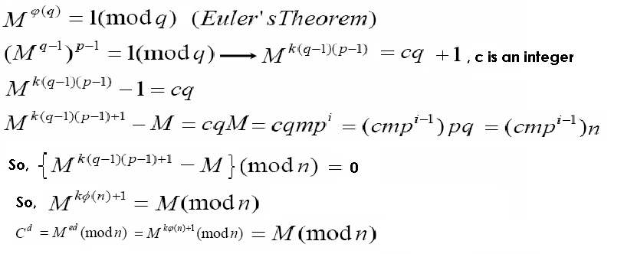
RSA – Proof 1, When GCD(M,n)!=1
When GCD(M,n)!=1; n =p *q, then n only have 4 possible divisors, 1, p, q, n, and M< n, so GCD (M, n) can be either p or q, now suppose GCD(M, n)=p, then M is a multiple of p, suppose M=m*p^i
When GCD(M,n)=q, i.e., when M is a multiple of q, the same logic applies. Note that M cannot be a multiple of p and q at the same time, since M <n.
CEG 260, Meilin Liu
Notes:
Zili Shao
All security policies and mechanisms rest on assumptions; we’ll examine some in later chapters, most notably Chapter 22, Malicious Logic. Here is a taste of the assumptions.
Policies: as these define security, they have to define security correctly for the particular site. For example, a web site has to be available, but if the security policy does not mention availability, the definition of security is inappropriate for the site. Also, a policy may not specify whether a particular state is “secure” or “non-secure.” This ambiguity causes problems.
Mechanisms: as these enforce policy, they must be appropriate. For example, cryptography does not assure availability, so using cryptography in the above situation won’t work. Further, security mechanisms rely on supporting infrastructure, such as compilers, libraries, the hardware, and networks to work correctly. Ken Thompson’s modified C preprocessor (see the example on p. 615) illustrates this point very well.

Slide 15
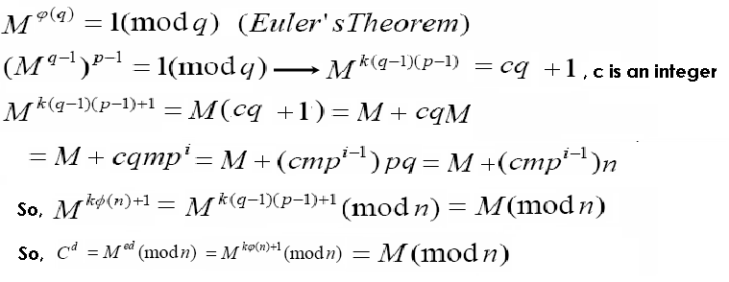
RSA –When GCD(M,n)!=1, Proof 2
When GCD(M,n)!=1; n =p *q, then n only have 4 possible divisors, 1, p, q, n, and M< n, so GCD (M, n) can be either p or q, now suppose GCD(M, n)=p, then M is a multiple of p, suppose M=m*p^i
When GCD(M,n)=q, i.e., when M is a multiple of q, the same logic applies. Note that M cannot be a multiple of p and q at the same time, since M <n
CEG 260, Meilin Liu
Notes:
Zili Shao
All security policies and mechanisms rest on assumptions; we’ll examine some in later chapters, most notably Chapter 22, Malicious Logic. Here is a taste of the assumptions.
Policies: as these define security, they have to define security correctly for the particular site. For example, a web site has to be available, but if the security policy does not mention availability, the definition of security is inappropriate for the site. Also, a policy may not specify whether a particular state is “secure” or “non-secure.” This ambiguity causes problems.
Mechanisms: as these enforce policy, they must be appropriate. For example, cryptography does not assure availability, so using cryptography in the above situation won’t work. Further, security mechanisms rely on supporting infrastructure, such as compilers, libraries, the hardware, and networks to work correctly. Ken Thompson’s modified C preprocessor (see the example on p. 615) illustrates this point very well.

Slide 16
RSA Example
Select primes: p=17 & q=11
Compute n = pq =17×11=187
Compute ø(n)=(p–1)(q-1)=16×10=160
Select e : gcd(e,160)=1; choose e=7
Determine d: de=1 mod 160 and d < 160
We get d=23, since 23×7=161= 10×160+1
Publish public key KU={7,187}
Keep secret private key KR={23,17,11}
CEG 260, Meilin Liu
Notes:
Zili Shao
Here walk through example using “trivial” sized numbers.
Selecting primes requires the use of primality tests.
Finding d as inverse of e mod ø(n) requires use of Inverse algorithm (see Ch4)

Slide 17
RSA Example – cont.
sample RSA encryption/decryption is:
given message M = 88 (88<187)
encryption:
  C = 88⁷ mod 187
  88¹ mod 187 =88, 88² mod 187 = 77,
  88⁴ mod 187 =132
  C = 88⁷ mod 187=(88¹ * 88² * 88⁴⁾ mod 187
  =(88*77*132) mod 187 =11
decryption:
  M = 11²³ mod 187
  11¹ mod 187 =11, 11² mod 187 = 121,
  11⁴ mod 187 =55, 11⁸ mod 187 =33,
  11^(16) mod 187 =33=154
  M = 11²³ mod 187= (11*121*55*154) mod 187 = 11273580 mod 187 = 88
CEG 260, Meilin Liu
Notes:
Zili Shao
Rather than having to laborious repeatedly multiply, can use the "square and multiply" algorithm with modulo reductions to implement all exponentiations quickly and efficiently (see next).

Slide 18
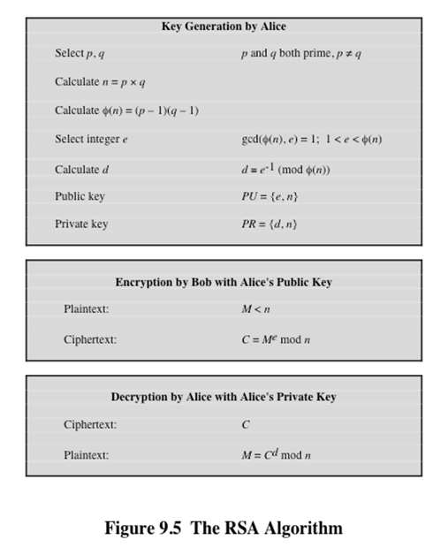

RSA Algorithm
CEG 260, Meilin Liu
Notes:
Zili Shao
So far all the cryptosystems discussed have been private/secret/single key (symmetric) systems. All classical, and modern block and stream ciphers are of this form.

Slide 19
RSA Applications
Very widely used:
  SSL/TLS: certificates and key-exchange
  Secure e-mail and file systems
  Many others
CEG 260, Meilin Liu
Notes:
Zili Shao

Slide 20
RSA With Low public exponent
To speed up RSA encryption use a small e: c = m^{e} (mod N)
Minimum value: e=3 ( gcd(e, ϕ(N) ) = 1)
Recommended value: e=65537=2¹⁶+1
Encryption: 17 multiplications
Asymmetry of RSA: fast encryption / slow decryption.

Slide 21
Key lengths
Security of public key system should be comparable to security of symmetric cipher:
RSA
Symmetric Cipher key-size Modulus size
80 bits 1024 bits
128 bits 3072 bits
256 bits (AES) 15360 bits

Slide 22
RSA Security
three approaches to attacking RSA:
  brute force key search (infeasible given size of numbers)
  mathematical attacks (based on difficulty of computing ø(N), by factoring modulus N)
  timing attacks (on running of decryption)
  Power Attack
  Faults Attack
CEG 260, Meilin Liu
Notes:
Zili Shao

Slide 23
Implementation attacks
Side channel attacks: Ciphertext only attack.
Timing attack:
The time it takes to compute c^{d} (mod N) can expose d
Power attack:
The power consumption of a smartcard while
it is computing c^{d} (mod N) can expose d.
Faults attack:
A computer error (reducing power) during c^{d} (mod N) can expose d.
A common defense:: check output (does encryption again to compute c,
to see if it matches. 10% slowdown.
Notes:
BB’04: Boneh-Brumley

Slide 24
Timing Attacks
Paul Kocher, a cryptographic consultant, demonstrated that a snooper can determine a private key by keeping track of how long a computer takes to decipher messages
Are applicable not just to RSA but to other public-key cryptography systems
Are alarming for two reasons:
  It comes from a completely unexpected direction
  It is a ciphertext-only attack
Notes:
If one needed yet another lesson about how difficult it is to
assess the security of a cryptographic algorithm, the appearance of timing attacks
provides a stunning one. Paul Kocher, a cryptographic consultant, demonstrated
that a snooper can determine a private key by keeping track of how long a computer
takes to decipher messages [KOCH96, KALI96b]. Timing attacks are applicable
not just to RSA, but to other public-key cryptography systems. This attack is alarming
for two reasons: It comes from a completely unexpected direction, and it is a
ciphertext-only attack.
A timing attack is somewhat analogous to a burglar guessing the combination
of a safe by observing how long it takes for someone to turn the dial from number
to number. We can explain the attack using the modular exponentiation algorithm
of Figure 9.8, but the attack can be adapted to work with any implementation that
does not run in fixed time. In this algorithm, modular exponentiation is accomplished
bit by bit, with one modular multiplication performed at each iteration and
an additional modular multiplication performed for each 1 bit.

Slide 25
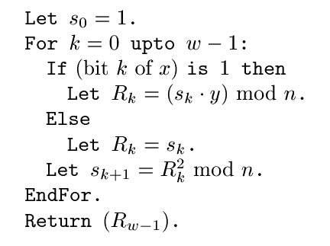
How Does RSA Decryption Work?
RSA decryption: compute y^{x} mod n
  This is a modular exponentiation operation
Naïve algorithm: square and multiply
slide <number>

Slide 26
Kocher’s Observation
Whether iteration takes a long time
depends on the k^{th} bit of secret exponent
This takes a while
to compute
This is instantaneous
slide <number>

Slide 27
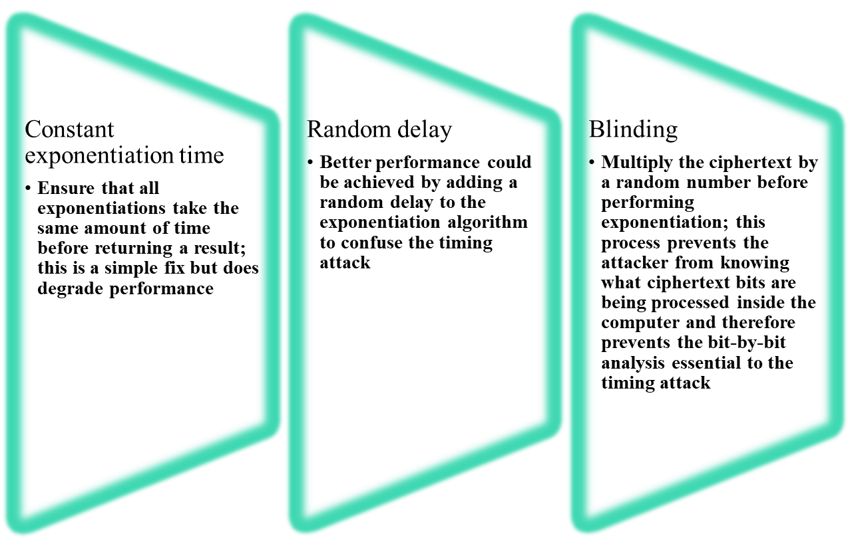
Countermeasures
Notes:
Although the timing attack is a serious threat, there are simple countermeasures
that can be used, including the following.
• Constant exponentiation time: Ensure that all exponentiations take the same
amount of time before returning a result. This is a simple fix but does degrade
performance.
• Random delay: Better performance could be achieved by adding a random
delay to the exponentiation algorithm to confuse the timing attack. Kocher
points out that if defenders don’t add enough noise, attackers could still succeed
by collecting additional measurements to compensate for the random delays.
• Blinding: Multiply the ciphertext by a random number before performing
exponentiation. This process prevents the attacker from knowing what ciphertext
bits are being processed inside the computer and therefore prevents the
bit-by-bit analysis essential to the timing attack.

Slide 28
Defenses
Good: Use RSA blinding
Worse: require statically that all decryptions take the same time
  For example, always do the extra “dummy” reduction
  … but what if compiler optimizes it away?
Worse: dynamically make all decryptions the same or multiples of the same time “quantum”
  Now all decryptions have to be as slow as the slowest decryption
slide <number>

Slide 29
RSA Blinding
Instead of decrypting ciphertext c, decrypt a random ciphertext related to c
  Compute x’ = c*r^{e} mod n, r is random
  Decrypt x’ to obtain m’
  Calculate original plaintext m = m’/r mod n
Since r is random, decryption time is random
2-10% performance penalty
slide <number>

Slide 30
Fault-Based Attack
An attack on a processor that is generating RSA digital signatures
  Induces faults in the signature computation by reducing the power to the processor
  The faults cause the software to produce invalid signatures which can then be analyzed by the attacker to recover the private key
The attack algorithm involves inducing single-bit errors and observing the results
While worthy of consideration, this attack does not appear to be a serious threat to RSA
  It requires that the attacker have physical access to the target machine and is able to directly control the input power to the processor
Notes:
Still another unorthodox approach to attacking RSA is reported
in [PELL10]. The approach is an attack on a processor that is generating
RSA digital signatures. The attack induces faults in the signature computation by
reducing the power to the processor. The faults cause the software to produce invalid
signatures, which can then be analyzed by the attacker to recover the private
key. The authors show how such an analysis can be done and then demonstrate it
by extracting a 1024-bit private RSA key in approximately 100 hours, using a commercially
available microprocessor.
The attack algorithm involves inducing single-bit errors and observing the results.
The details are provided in [PELL10], which also references other proposed
hardware fault-based attacks against RSA.
This attack, while worthy of consideration, does not appear to be a serious
threat to RSA. It requires that the attacker have physical access to the target
machine and that the attacker is able to directly control the input power to the
processor. Controlling the input power would for most hardware require more than
simply controlling the AC power, but would also involve the power supply control
hardware on the chip.

Slide 31
Chosen Ciphertext Attack (CCA)
CCA is defined as an attack that the adversary chooses a number of ciphertexts and is then given the corresponding plaintexts, decrypted with the target’s private key.
Thus the adversary could select a plaintext, encrypt it with the target’s public key, and then be able to get the plaintext back by having it decrypted with the private key
The adversary exploits properties of RSA and selects blocks of data that, when processed using the target’s private key, yield information needed for cryptanalysis
To counter such attacks, RSA Security Inc. recommends modifying the plaintext using a procedure known as optimal asymmetric encryption padding (OAEP)
CEG 260, Meilin Liu
Notes:
Zili Shao

Slide 32
PKCS #1 v2.1 (e.g., OAEP)
m || 0…0
r
G
H
e
c =
m₁
m₂
mod N

Slide 33
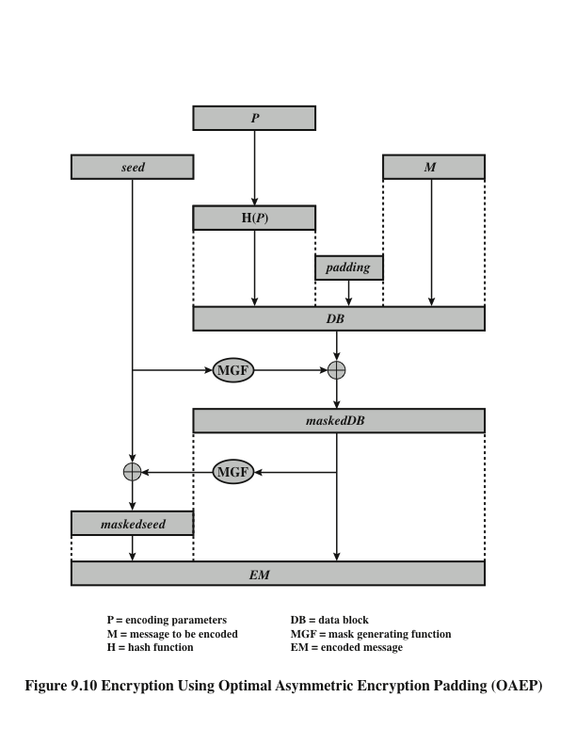
Optimal Asymmetric Encryption Padding (OAEP)
Notes:
Figure 9.10 depicts OAEP encryption. As a first step, the message M to be
encrypted is padded. A set of optional parameters, P , is passed through a hash
function, H. The output is then padded with zeros to get the desired length in the
overall data block (DB). Next, a random seed is generated and passed through
another hash function, called the mask generating function (MGF). The resulting
hash value is bit-by-bit XORed with DB to produce a maskedDB. The maskedDB
is in turn passed through the MGF to form a hash that is XORed with the seed
to produce the masked seed. The concatenation of the masked-seed and the
maskedDB forms the encoded message EM. Note that the EM includes the padded
message, masked by the seed, and the seed, masked by the maskedDB. The EM is
then encrypted using RSA.

Slide 34
Exponentiation
Finite cyclic group G (for example G = Zp* )
Goal: given g in G and x compute g^{x}
Example: suppose x = 53 = (110101)₂ = 32+16+4+1
Then: g⁵³ = g³²⁺¹⁶⁺⁴⁺¹ = g³²⋅g¹⁶⋅g⁴⋅g¹
g ⟶ g² ⟶ g⁴ ⟶ g⁸ ⟶ g¹⁶ ⟶ g³² g⁵³

Slide 35
The repeated squaring alg.
Input: g in G and x>0 ; Output: g^{x}
write x = (x_{n} x_{n-1} … x₂ x₁ x₀)₂
y ⟵ g, z ⟵ 1
for i = 0 to n do:
if (x[i] == 1): z ⟵ z⋅y
y ⟵ y²
output z
example: g⁵³
y z
g² g
g⁴ g
g⁸ g⁵
g¹⁶ g⁵
g³² g²¹
g⁶⁴ g⁵³

